Slide 1
Pivot with Podcasts
https://padlet.com/morgan_dunton/2020ELAvirtual
Three Phase Approach to Flexible Curriculum Design
Notes:
Morgan

Slide 2
RECORDINGS
Part 1: https://youtu.be/nO2Cpi846dc
Part 2: https://youtu.be/GRrq6elFBzA

Slide 3
Contact Us
Jon Graham, Elementary Digital Learning Specialist
Emma-Marie Banks, Secondary Digital Learning Specialist
Morgan Dunton English Language Arts Specialist, Grades 6-12
Notes:
Morgan

Slide 4
Three Phase Pivot
Phase 1
Bring the media into the classroom as a genre study.
Phase 2
Collaborate and plan.
Phase 3
Present
Notes:
Morgan

Slide 5
Phase 1: Study
Goal: Demonstrate an understanding of a podcast including structure, critical elements, purpose, and preferred qualities.
Essential question (genre study) - When is a podcast a preferred mode of sharing information?
Notes:
Morgan

Slide 6
UPDATED ELA Standards
READING: Craft and Structure
R.8:Analyze the structure of various texts, including how the features and components relate to each other and the whole.
R.9:Assess how perspective or purpose shapes the content and style of a text.
Notes:
Morgan

Slide 7
UPDATED ELA Standards
READING: Integration of Knowledge and Ideas
R.11:Analyze and evaluate content presented in various texts (e.g. literary, historical, visual, artistic, quantitative, technological).
Notes:
Morgan

Slide 8
UPDATED ELA Standards
SPEAKING AND LISTENING: Comprehension and Collaboration
SL.2:Integrate and evaluate information presented in diverse media and formats, including point of view, reasoning, and use of evidence and rhetoric.
Notes:
Morgan

Slide 9
REFLECT ON THE PREVIOUS STANDARDS AS A SINGLE BODY
HOW ARE THESE STANDARDS RELATED?
WHAT OTHER CONTENT AREAS MIGHT BE INCLUDED OR RELATED?
Notes:
MORGAN shifting thinking from small grain to bigger picture

Slide 10
PODCASTS
PHASE 1: THE GENRE OF PODCASTS
Notes:
Jon starts here

Slide 11
pod·cast
/ˈpädˌkast/, noun
a digital audio file made available on the Internet for downloading to a computer or portable media player, typically available as a series, new installments of which can be received by subscribers automatically.
from podcastbroadcast.com
Notes:
Jon

Slide 12
1.Podcasts
What? Who? When? Where? Why?
(We’ll get to the “How” later…)
Notes:
Jon

Slide 13
In the fall of 2014, Serial, a spinoff of This American Life, hit the scene and became a cultural phenomenon. It turned on a new audience to the world of podcasting by taking the popularity of true crime and bringing it to this medium.
Notes:
Jon

Slide 14
What will your kids know about podcasts?
Very little.
They aren’t the target audience
(not unlike message boards & blogs)
If their parents are into NPR, talk radio or sports radio… they might have a sense
They might have a sense via YouTube videos (product reviews and the like)
Notes:
Jon

Slide 15
Since they don’t know about podcasts, you will need to introduce them...
Notes:
Jon

Slide 16
PODCASTS vs. MOVIES vs. IMAGES
mix
of audio & video
audio & video quality
are both key elements
audio & visual PLUS filters & special effects
pre- & post-
production
is huge
pure audio
audio recording quality is key
music & textures
guide audience
pre- &
post-production are
dependent on
audience
pure
visual
clarity of image(s)
is necessary
visual styles & composition guide
audience
pre-production is
huge; post-
is minimal
Notes:
Jon

Slide 17
We’re talking about audio
The absence of visuals is both
an advantage and a disadvantage
Notes:
Jon

Slide 18
Identifying the Qualities of a poor podcast
Technical Issues vs. Presenter Issues
Once you do podcasts with students, you’ll have the advantage of using them as examples (both good & bad). Students often enjoy pointing out what is wrong with something (although many will commit the same sins).
Notes:
Jon

Slide 19
Technical Issues
too quiet or too loud
uneven audio (Levelator is software that can help)
music or sounds overwhelm speaker’s voice
poor microphone (popping P’s or buzzing)
Notes:
Jon

Slide 20
Presenter Issues
too many umm’s, uhh’s, you know’s or like’s…
speaker talking too fast or too unclearly
music used as an unnecessary filler
speaker is clearly unprepared
dead air
alters voice unnecessary
Notes:
Jon

Slide 21
Great podcasts
Not-so-great podcasts
Notes:
Jon

Slide 22
Do you have any that you like?
Why?
Great content? Great quality?
Notes:
Jon

Slide 23
Use a podcast (or part of one)
to introduce new content or enrich previously covered content
Notes:
Jon

Slide 24
TASK: Analyze a podcast
Notes:
Morgan

Slide 25
Podcast analysis (ELA standards aligned)
Analyze a podcast for
Craft and structure
Integration of knowledge and ideas
Comprehension
Pass/feedback criteria included
Notes:
Morgan: live link to a document - graphic organizer and criteria.

Slide 26
FEEDBACK to meet pass criteria ANALYSIS is the primary goal
Something to address | CRITERIA: Response sufficiently addresses each area | reflection
 | Intended audience
 | Purpose
 | Structure
 | Evidence within podcast
 | Podcast qualities
Notes:
Morgan: criteria and feedback options provide direction for completing the task.

Slide 27
What Are GREAT podcasts?
“Edutainment”
Freakanomics Radio
Backstory
Radiolab
Gastropod
The Allusionist
Storytelling
(fiction & non-fiction)
This American Life
Everything is Alive
Lore
Limetown
The Black Tapes
The Message
Niche interest
Parcast Network
(for true crime, cults, conspiracy theories)
Gilmore Guys
(for watchers of “Gilmore Girls”)
99% Invisible
(about design & architecture)
More Perfect
(Supreme Court)
Notes:
Jon

Slide 28
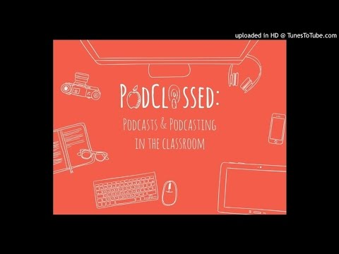
CLIPs from
“This American Life - Episode 516: Stuck in the Middle” - 0:00
“RadioLab - Rodney versus Death” - 4:00
“Gastropod - Savor Flavor” - 5:53
“Lore - Episode 11 - Black Stockings” - 6:53
Strong
Narrative Voice
Music for
Mood Setting
Pacing & Tempo
Thorough,
Yet Concise
Intros
of People, Places & Things
Notes:
Jon plays audio; perhaps skipping ahead

Slide 29
PHASE 2:
COLLABORATION AND PLANNING
Demonstrate the ability to explore a critical topic, gather effective information, and develop a plan to present.
Notes:
Morgan

Slide 30
UPDATED ELA STANDARDS
WRITING: Inquiry to Build and Present Knowledge
W.1: Use an inquiry process to gather relevant, credible information/evidence from a variety of sources (e.g., print, digital, discussions, etc.) that build understanding of and lead to conclusions about a subject under investigation while avoiding plagiarism.
WRITING: Process and Production
W.2: Develop, strengthen, and produce polished writing by using a collaborative process that includes the age-appropriate use of technology.

Slide 31
UPDATED ELA STANDARDS
READING: Key Ideas and Details
R.4: Read various texts closely to determine what each text explicitly says and to make logical inferences; cite specific textual evidence to support conclusions drawn from the text.
R.6: Analyze how and why individuals, events, and ideas develop and interact over the course of a text.
READING: Integration of Knowledge and Ideas
R.10: Evaluate the argument and specific claims in various texts.
Notes:
Morgan

Slide 32
UPDATED ELA STANDARDS
SPEAKING AND LISTENING: Comprehension and Collaboration
SL.1: Prepare for and participate in conversations across a range of topics, types, and forums, building on others’ ideas and expressing their own.
Notes:
Morgan

Slide 33
Would You… Could You… Should You… Make a Podcast?
for Students
Introduce content
Personalize content
Enrich content
for Parents
Replace newsletter
Student-driven content
for Colleagues
Share successes
Share resources
Share ideas
Notes:
Emma

Slide 34
Preparedness Happens in Pre-Production
Topic & Audience
Collaboration
Formatting
Interviews & Research
(Inquiry)
Storyboarding
Notes:
Emma

Slide 35
Preparedness Happens in Pre-Production
Topic & Audience
Collaboration
Formatting
Interviews & Research
(Inquiry)
Storyboarding
Notes:
Emma

Slide 36
Topic & Audience
What is your topic?
How much research is needed?
Who is your audience?
How much prior knowledge will they have?
Notes:
Emma

Slide 37
Preparedness Happens in Pre-Production
Topic & Audience
Collaboration
Formatting
Interviews & Research
(Inquiry)
Storyboarding
Notes:
Emma

Slide 38
Collaboration
Will You work with Others?
How will you compliment one another?
How will you divide up the work?
Notes:
Emma

Slide 39
Preparedness Happens in Pre-Production
Topic & Audience
Collaboration
Formatting
Interviews & Research
(Inquiry)
Storyboarding
Notes:
Emma

Slide 40
Interviews & Research (Inquiry)
What information are you collecting?
How will you collect this information?
Are you planning an interview?
Consider…Time & Place,
Question Structure, and Order.
Notes:
Emma

Slide 41
Preparedness Happens in Pre-Production
Topic & Audience
Collaboration
Formatting
Interviews & Research
(Inquiry)
Storyboarding
Notes:
Emma

Slide 42
Storyboarding
Notes - lower quality, more free flowing
Script - Higher quality, Less Natural
Do you want to do post-production cleanup?
What will fit your “style”?
Notes:
Emma

Slide 43
Preparedness Happens in Pre-Production
Topic & Audience
Collaboration
Formatting
Interviews & Research
(Inquiry)
Storyboarding
Notes:
Emma

Slide 44
Formatting
This is a Must! Have it in front of you.
What Parts & Segments Will You Have?
Intros & Outros, Open & Close, Body, Etc.
Notes:
Emma

Slide 45
TASK: Collaborate to explore a topic and plan a podcast.
Notes:
Emma

Slide 46
END OF SESSION 1, 5/5/2020

Slide 47
5/12/2020 PHASE 3:
PRESENTATION
Why would and why should an audience listen to this podcast?
Notes:
Morgan

Slide 48
UPDATED ELA STANDARDS
SPEAKING AND LISTENING: Presentation of Knowledge and Ideas
SL.3: Present information and supporting evidence appropriate to task, purpose, and audience so that listeners can follow the line of reasoning and incorporate multimedia when appropriate.
SL.4: Adapt speech to a variety of contexts, audiences, and communicative tasks.

Slide 49
UPDATED ELA STANDARDS
WRITING: Composing for Audience and Purpose
W.3: Routinely produce a variety of clear and coherent writing in which the development, organization, and style are appropriate to task, audience, and purpose.
Notes:
Morgan

Slide 50
UPDATED ELA STANDARDS
LANGUAGE: Conventions of Standard English
L.1: Demonstrate command of the conventions of standard English grammar and usage when writing or speaking.
LANGUAGE: Knowledge of Language
L.3: Apply knowledge of language to understand how language functions in different contexts, to make effective choices for meaning or style, and to comprehend more fully when reading or listening.
Notes:
Morgan

Slide 51
RECORDING
You and your students will most likely experience these, so be warned and plan accordingly
Notes:
Jon

Slide 52
5 Stumbling Blocks
You and your students will most likely experience these, so be warned and plan accordingly
Notes:
Jon

Slide 53
Red Light Fever
This particular sort of nervousness has a name for a reason. Just starting is half the battle...

Slide 54
OverProduction
Music, sound fx and audio textures can set a mood, add depth or cleanse the pallet, but only if used carefully

Slide 55
The Giggles
Once the nervousness subsides, the silliness washes in and words are drowned with giggles

Slide 56
Your Voice
EVERYONE hates the sound of their own voice, there are scientific reasons. We’re all used to it, so you need to get used to it too!

Slide 57
Unprepared
When it’s time to record, it is not time to plan, do research or think about things… it’s time to record
Notes:
Jon

Slide 58
Example of a Technical WorkFlow
Post-Production
2
3
Pre-Production
Production
1
Setup time & place to record
Record
Listen to Raw Recording
Re-Record Pieces As Needed
Sound Checks & Equipment Prep
Begin Editing
Insert Audio and Music as needed
Edit Until “Complete”
Render a Final Copy for sharing, uploading, emailing, etc.

Slide 59
Hardware & Software
inexpensive (even free) options are out there for doing quality audio recording!

Slide 60
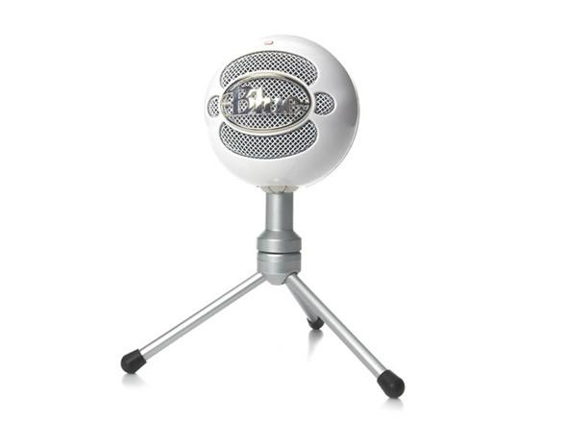
Blue Microphone’s Snowball
$50
Podcasts
Presentations
Live Music
… is VERSATILE, Multi-Platform Compatible & Affordable

Slide 61
Can it Connect to a...
Laptop with Windows OS (ex. HP Probook)?
Yes, as long the device has a working USB
Laptop with Mac OS (ex. Macbook Air)?
Yes, as long the device has a working USB
Laptop with Chrome OS?
Yes, as long the device has a working USB
iPad or iPhone?
Yes, they just need the appropriate “camera kit” piece
Lightning-to-USB

Slide 62
PodCasting on the iPad
What the available apps lack in complexity, they make up for it in ease of use

Slide 63
Apps To Help
“GarageBand”
recording & editing
$4.99!
“Opinion”
editing available
limited to 10 mins per recording (free version)
“MP3 Sound Recorder”
auto upload to Drive or Dropbox
limited to 3 mins per recording (free version)
no editing
Soundtrap
web-based app worth trying
editing is available
audio recording currently is not
some limitations with free version

Slide 64
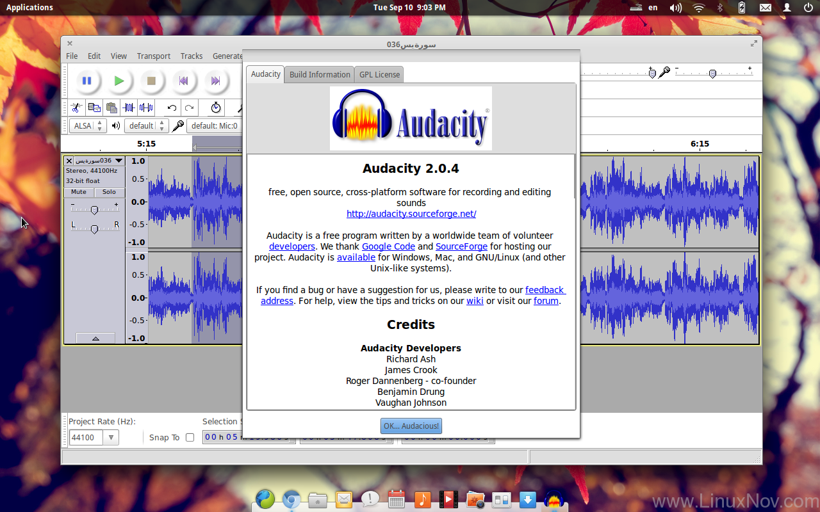
Place your screenshot here
PodCasting on a LapTop
Users have the benefit of powerful software, downloadable audio files and more options for external audio

Slide 65
What to Use to Record & Edit
Installed Software
GarageBand
(native to Mac)
Audacity (Windows or Mac)
need more
try:

Slide 66
What to Use to Record & Edit
One-shot recorders
Vocaroo
RecordMP3Online
Audior.ec
Cutters & Joiners
CutMP3
MP3Cut
Audio-Joiner
Full Editors
Soundtrap (collaborative potential, free FULL access for 30 days)
AudioTool
Soundation
UJam
Clyp.it

Slide 67
Some useful Tools (for our GAFE schools)
Google Hangouts on Air
Live “podcasting” potential; hosted by YouTube
Google Drive
Storing, hosting & sharing podcasts
Google Voice
Recording a phone interview
TunestoTube
Easily upload an MP3 with a photo to YouTube
Soundtrap, AudioTool, Soundation & UJam
Can be logged into and/or store through your account

Slide 68
Resources & References
Podcastbroadcast.org
HowToPodcastTutorial.com
“12 Ways to Use a Tablet” from TheAudacityToPodcast.com
“Podcast Evaluation Form” from my own class
“Hosting Podcasts on Google Drive” from labnol.org
“Kirk’s 8 Rules of Effective Podcasting” from McLhearn.com
“5 Ways to Record Podcast Interviews with an iPhone” from TheMobilePro.net
“ Audacity & Audio’s The 20 in their 20s of Podcasting” from Medium.com
“There’s A Real Reason You Can’t Stand The Sound Of Your Own Voice” from EliteDaily.com
“SHOUT OUT: A Kid’s Guide to Recording Stories” from Transom.org

Slide 69
Contact Us
Jon Graham Elementary Digital Learning Specialist
Emma-Marie Banks Secondary Digital Learning Specialist
Morgan Dunton English Language Arts Specialist, Grades 6-12
https://forms.gle/etDeRHow4Je613LF9

